Slide 1

Azure HDInsight (Apache Hadoop in Azure)

Slide 2
Apache Hadoop 101

Slide 3

Apache Hadoop
Apache 基金會下的開源專案
可高度延展的分散式檔案系統 (HDFS)
運算及資料處理皆是以分散式完成
資料規模
資料多樣性
資料時效性

Slide 4
Apache Hadoop Portfolio of Projects
Apache 基金會下的開源專案
可高度延展的分散式檔案系統 (HDFS)
運算及資料處理皆是以分散式完成
管理及監控
存取資料
安全
操作
資料操作流程、生命週期以及管理
Falcon
Sqoop
Flume
NFS
WebHDFS
批次
Map reduce
Script
Pig
SQL
Hive/Tez, HCatalog
NoSQL
Hbase
Accumulo
串流
Storm
搜尋
Solr
其它
Spark, in-memory,
ISV engines
身份驗證
授權操作
操作記錄管理
資料保護
Storage: HDFS
Resources: YARN
Access: Hive, …
Pipeline: Falcon
Cluster: Knox
啟用、管理及監控
Ambari
Zookeeper
YARN: data operating system
HDFS (Hadoop Distributed File System)
1
°
°
°
°
°
°
°
°
°
°
排程
Oozie
°
°
°
°
°
°
°
°
°
°
°
°
°
°
°
°
°
°
°
N
資料管理

Slide 5

資料規模
Hadoop 使用分散式檔案系統儲存檔案
檔案的儲存以及程式的運算都分散在多台伺服器中
同一份檔案可以被分散儲存在多台伺服器中
Hadoop 可以用來處理巨量的資料
能夠根據需求很快延展多台伺服器來處理資料
延展的複雜度是線性的
也能夠處理特別大的單一檔案
檔案

Slide 6
資料多樣性
Hadoop 可以用來儲存多種檔案 (非關聯式儲存)
檔案可以是結構化或是非結構化的資料
在過去，可能還不知道如何從這些資料中找到新的可能性
而現在，透過 Hadoop 讓我們有能力，透過資料科學，從巨量資料中找到新的商業價值
情緒資料
即刻瞭解客戶對於您產品的滿意度，以及他們的想法
點擊流
蒐集並分析訪客在網站上瀏覽的方式，藉此改善網站操作流程，增加成交量
感測器
透過感測器自動蒐集遠端環境或機器的各種數值來分析
地理資料
分析具有地理資訊的資料以瞭解事件的發生與地域的關係
伺服器記錄
從伺服器記錄中分析伺服器運作狀況，以預防錯誤及安全問題的發生
非結構化資料
從各種的檔案中瞭解其關聯性

Slide 7



資料時效性
Hadoop 能即時串流及處理資料
Hadoop 可以用來當作具有延展性的事件串流擷取工具使用
Hadoop 能夠近乎即時的 “串流中” 資料處理
資料輸入
事件接收
串流處理
輸出
應用程式
事入輸入
事件輸出
裝置
HTTP

Slide 8
Hadoop 架構.
2.0
MapReduce
HBase
Hive
Storm
Yarn
分散式檔案系統
(HDFS)

Slide 9
工欲善其事，必先利其器
延展性 (資料的儲存與處理)
Relational
Database
Hadoop
Platform
schema
寫入資料時須確定
讀取資料時須確定
speed
讀取資料速度快
寫入資料速度快
governance
標準且結構化
結構鬆散
processing
沒有資料處理
可做資料處理
data types
結構化
多樣且非結構化
best fit use
互動式 OLAP 分析
複雜的 ACID 交易
儲存操作性資料
Data Discovery
處理非結構化資料
大量儲存或資料處理

Slide 10
YARN: 新世代的 Hadoop
Single Use System
Batch Apps
Multi Use Data Platform
Batch, Interactive, Online, Streaming, …
第一代 Hadoop
第二代 Hadoop
Classic Hadoop Apps
Flexible Data
Processing
Hive, Pig, others…
Online Data
Processing
HBase, Accumulo
Stream
Processing
Storm
others …
Batch
MapReduce
Batch & Interactive
Tez
MapReduce
(cluster resource management
& data processing)
Efficient Cluster Resource Management & Shared Services
(YARN)
HDFS
(redundant, reliable storage)
Redundant, Reliable Storage
(HDFS)

Slide 11
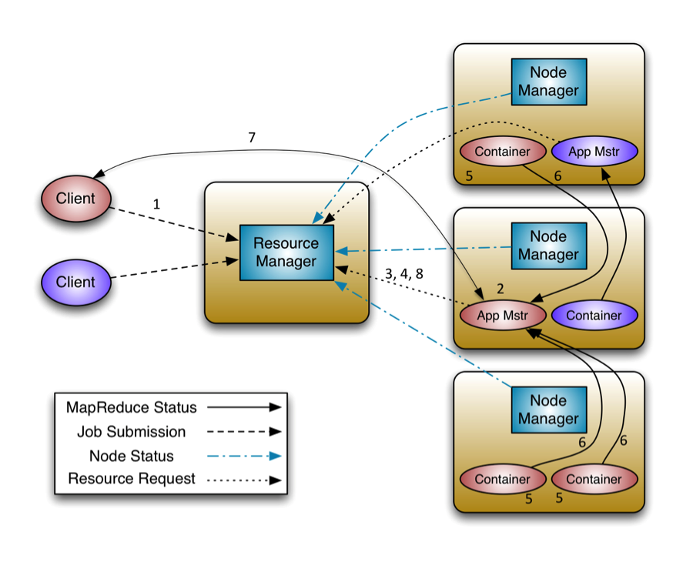
Hadoop 2.0: Yarn
http://hortonworks.com/blog/introducing-apache-hadoop-yarn/

Slide 12



YARN: Data Operating System
ResourceManager
Scheduler
NodeManager
NodeManager
NodeManager
NodeManager
map _{1.1}
nimbus₀
vertex_{1.1.1}
vertex_{1.2.2}
NodeManager
NodeManager
NodeManager
NodeManager
map_{1.2}
Batch
Interactive SQL
vertex_{1.1.2}
nimbus₂
NodeManager
NodeManager
NodeManager
NodeManager
nimbus₁
Real-Time
vertex_{1.2.1}
reduce_{1.1}

Slide 13
HDFS: Hadoop 的儲存體
資料節點 (Datanode)
Distributed Environment
Local storage
Fault tolerant
Makes (3) copies of each block
The # of copies is configurable
Reads a file and splits it up into blocks
名稱節點 (Namenode)
Does NOT store blocks of data
Keeps track of where the blocks are mapped on the other nodes (servers)

Slide 14
Hadoop MapReduce
用來分析儲存在 HDFS 中資料的程式開發框架(包含函式庫及執行階段)
由 Map 及 Reduce 兩功能組成:
Map() – 將工作切割處理
Reduce() – 合併處理好的工作結果
1. 將問題切割成小問題.
………
Map()
2. 針對每個小問題套用相同的工作流程.
Do work()
Do work()
Do work()
3. 合併每個小工作輸出的結果.
Reduce()
Output
Notes:
Talk Track: Let’s go over the main concepts for MapReduce. Hadoop MapReduce is a programming and runtime framework for analyzing datasets stored in HDFS. It’s designed to let you write applications that rapidly process vast amounts of data in parallel on a large cluster of compute nodes.
MapReduce jobs are composed of user-supplied Map and Reduce functions. Map functions take a divide and conquer approach to processing data as fast as possible. Reduce functions combine and reduce cardinality. The MapReduce framework provides all the “glue” and coordinates the execution of the Map and Reduce jobs on the cluster.
Map functions take a large problem and divide it into sub-problems and perform the same function on all sub-problems. Reduce functions perform the Combine process, which takes the output from all sub-problems and creates a result set out of it. Often this output is in the form of a delimited text file that can be easily consumed by the speed and serving layers.
Key Points:
Map: Subdivide tasks into smaller sub-tasks, and sends across various reducers
Reduce: Combine the sub-tasks and reduce cardinality
References:
Using MapReduce with HDInsight: http://www.windowsazure.com/en-us/manage/services/hdinsight/using-mapreduce-with-hdinsight/

Slide 15
MapReduce 程式範例
Twinkle, twinkle, little star
How I wonder what you are
Up above the world so high
Like a diamond in the sky
程式 = 一堆 “map” 及 “reduce” 的工作所組成
平行處理大量的資料
將工作切割成相互獨立的小工作再分配到多台電腦上處理
Map
Map
Map
Map
twinkle 2
little 1
star 1
how 1
I 1
wonder 1
what 1
you 1
are 1
up 1
above 1
the 1
world 1
so 1
high 1
like 1
a 1
diamond 1
in 1
the 1
sky 1
Shuffle/Sort
Reduce
Reduce
twinkle 2
how 1
I 1
the 2
…
little 1
star 1
wonder 1
you 2
…

Slide 16

Azure HDInsight

Slide 17


使用 Hadoop 的挑戰
伺服器硬體成本
資源規劃
對 Hadoop 的專業
Notes:
Hardware acquisition (Capex up front)
Scale constrained to on-premise procurement (resource and capacity planning)
Skilled Hadoop Expertise Tuning + Maintenance

Slide 18






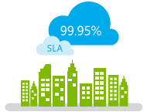


為什麼雲端平台適合處理巨量資料
快速
延展
經濟
大數據 3V
大規模的運算 及儲存資料
部署專家
爭取時效
服務不中斷
開放多元
Notes:
Gartner has increased its sizing and forecast for cloud compute services, reflecting greater interest among our client base than had been expected. We expect the 2013 market to be worth $8 billion (up from $6.8 billion forecast last year) and the 2014 market to be worth $10 billion.

Slide 19

為什麼要在雲端平台用 Hadoop
節省硬體成本
容易增加資源
根據用量付費
容易部署
$0
Benefits of Cloud
Unlimited elastic scale
Auto geo redundancy
No hardware costs
Pay only for what you need
Notes:
Why Hadoop in the cloud?
You can deploy Hadoop in a traditional on-site datacenter. Some companies–including Microsoft–also offer Hadoop as a cloud-based service. One obvious question is: why use Hadoop in the cloud? Here's why a growing number of organizations are choosing this option.
The cloud saves time and money
Open source doesn't mean free. Deploying Hadoop on-premises still requires servers and skilled Hadoop experts to set up, tune, and maintain them. A cloud service lets you spin up a Hadoop cluster in minutes without up-front costs.
See how Virginia Tech is using Microsoft's cloud instead of spending millions of dollars to establish their own supercomputing center.
The cloud is flexible and scales fast
In the Microsoft Azure cloud, you pay only for the compute and storage you use, when you use it. Spin up a Hadoop cluster, analyze your data, then shut it down to stop the meter.
We quickly spun up the Azure HDInsight cluster and processed six years worth of data in just a few hours, and then we shut it down&ellipsis; processing the data in the cloud made it very affordable.
–Paul Henderson, National Health Service (U.K.)
The cloud makes you nimble
Create a Hadoop cluster in minutes–and add nodes on-demand. The cloud offers organizations immediate time to value.
It was simply so much faster to do this in the cloud with Windows Azure. We were able to implement the solution and start working with data in less than a week.
–Morten Meldgaard, Chr. Hansen

Slide 20
混合部署 Hadoop 的情境
Cloud
Cloud
Cloud
Cloud
開發或 POC
迅速成長
備份或存檔
自建 Hadoop 平台
Appliances
Software

Slide 21



Hadoop On Your Terms
Microsoft Azure HDInsight
100% Apache Hadoop-based Service in the Cloud
Hortonworks Data Platform is now Microsoft Azure Certified
Cloudera Selects Microsoft Azure as a Preferred Cloud Platform
Qubole Partners with Microsoft Azure
Notes:
Discuss the breath of support in Azure for Hadoop workloads.
HDInsight was already covered in another session earlier in the day. Rearticulate the nature that it is a service, which includes support.
Hortonworks and Cloudera also support deployment to IaaS, or VMs in Azure. These may be custom scripted or through a marketplace deployment model.
Qubole is a partner who has a cloud deployment model, more akin to SaaS. This solution was born in the cloud and is designed to naturally take advantage of cloud capabilities.

Slide 22
HDInsight: 有什麼不同?
Hadoop 核心完全相同
可以選擇 Hadoop on Windows/Linux
可以透過 RDP, SSH 或 Script Action 來客製化環境
像是安裝 Spark, R, Kafka, Solr, Girafe 等軟體
運算與儲存體分離
使用 Azure Blob 儲存體

Slide 23
Ready for Deployment
Accepted
Cluster Storage Provisioned
AzureVM Configuration
Customize Cluster?
Running
Cluster Operational
No
Configuring HDInsight
Timed Out
Error
Yes
Cluster Customization

Slide 24


HDInsight 儲存體架構
Azure Blob 儲存體
Azure Flat Network Storage
HDInsight 運算節點 (大型虛擬機器)
http://dennyglee.com/2013/03/18/why-use-blob-storage-with-hdinsight-on-azure/
Notes:
WASB is communication layer that allows Azure Blob Storage to look like HDFS to Hdinsight
Speed is from Azure flat storage (quantum 10 storage)
Mesh grid network - high badnwidth

Slide 25
HDInsight 儲存體架構
串流資料 以供運算
將資料 儲存回 Blob 中
Azure Blob 儲存體
Azure Flat Network Storage
map
sort
shuffle
reduce
HDInsight 運算節點 (大型虛擬機器)
http://dennyglee.com/2013/03/18/why-use-blob-storage-with-hdinsight-on-azure/
Notes:
Hdinsight streams data to compute node
Many of the operations are done locally on compute node
Shuffle tasks will use some network to move less mapped data to reducers
Final step is moving the smallest amount of data back to the storage
In other words - network is heavily used in first phase for streaming
Common queries are smaller data sets and are streaming smaller amounts of data to each individual node
WASB provides faster write performance
The access methods are the same so you can specify file split size on either to maximize mapper progress and scale
No data durability SLA for local HDFS storage but Azure blob storage does!
Aggregate backplane of 50TBps for each azure datacenter

Slide 26
在 HDInsight 中使用 Azure 儲存體
存取 URI 範例
wasb://[<container>@]<accountname>.blob.core.windows.net/<path>
<property>
<name>fs.azure.account.key.<accountname>.blob.core.microsoft.com</name>
<value><enterthekeyvaluehere></value>
</property>
Notes:
Azure storage stores this data in page blobs
Most commands like LS and copyfromlocal work fine, but fsChk and dfsadmin or dfs commands will have different results within WASB
Default file system, containers in same storage account, any public containers or blobs, and containers in other storage accounts with private access levels (if you add an entry to your core-site.xml file
Love changes to property when cluster drops – lose some agility

Slide 27
在 Hadoop 中整理資料

Slide 28


使用 Hive & Pig 來準備資料
在鬆散的檔案上建立結構
透過類似 SQL 的語法來處理資料
產生並執行 MapReduce 操作
專注於 “資料倉儲”
處理並格式化資料
Scripting language for ETL/ELT
產生並執行 MapReduce

Slide 29
Apache Hive
在資料中套用結構
便於讀取資料時可得到結構
使用類似 SQL 的查詢語法 -- HiveQL 來查詢資料
類 SQL 操作介面
不必使用 Java
透過 HiveQL 語法來查詢資料 (轉換成 MapReduce 操作)
透過 Hive ODBC 連結 Microsoft BI 及 Excel

Slide 30


Hive 架構
Hive
HiveQL
Metastore
ODBC
JDBC
Hive Web Interface (HWI)
Command Line Interface (CLI)
Thrift Server
Compiler, Optimizer, Executor
Hadoop
Head Node
Name Node
Data Nodes / Task Nodes
Notes:
Thrift server has client and server components for translation between ODBC and Hadoop MR. It provides and interface definition language for RPC
Hive/HiveQL is simple, easy for SQL pros to learn
Hive design principles
Scalable, extensible (via UDF, UDAF), fault tolerant, and loose coupling with file formats.
What Hive is not
Low latency response times on queries.
Data warehousing framework on Hadoop
Imposes metadata / familiar looking HiveQL
Simple translation layer for MapReduce
Extensible via custom mappers/reducers
Loose coupling with input formats
Enables analytics from high level BI tools via ODBC

Slide 31
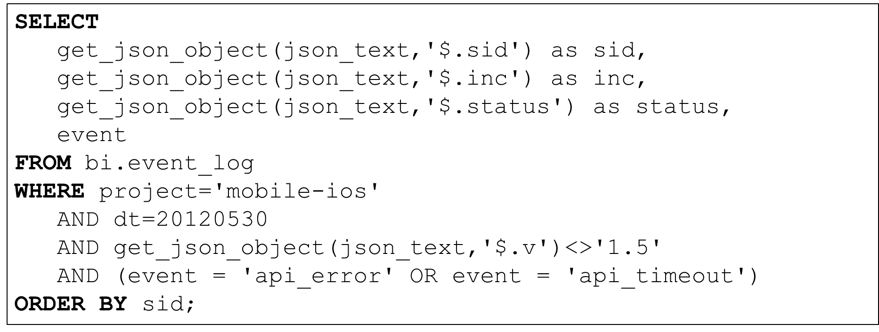
Hive 語法
Metastore
Hive
Engine
MapReduce
HDFS

Slide 32
Hive with Tez as Execution Engine
SELECT a.state, COUNT(*), AVERAGE(c.price)
FROM a
JOIN b ON (a.id = b.id)
JOIN c ON (a.itemId = c.itemId)
GROUP BY a.state
Tez avoids unneeded writes to HDFS
Hive – MR | Hive – Tez
M
M
M
SELECT a.state,
c.itemId
M
M
M
SELECT a.state
SELECT b.id
R
R
R
R
SELECT b.id
HDFS
M
M
M
M
JOIN (a, c)
SELECT c.price
M
M
R
R
R
HDFS
JOIN (a, c)
R
HDFS
JOIN(a, b)
GROUP BY a.state
COUNT(*)
AVERAGE(c.price)
M
M
JOIN(a, b)
GROUP BY a.state
COUNT(*)
AVERAGE(c.price)
R
R

Slide 33
常見的 Hive 敘述句
SHOW TABLES; 顯示資料表名稱
DESCRIBE hivesampletable; 取得資料表的結構
SELECT devicemodel, SUM(querydwelltime) as total dwelltime FROM hivesampletable GROUP BY devicemodel ORDER BY totaldwelltime DESC limit 10;
Returns total dwelltime for each device model in descending order by totaldwelltime for the top 10 device models
Explain query;
同 “Showplan” 敘述句

Slide 34
使用 Hive 準備資料 External and Internal Tables
CREATE EXTERNAL TABLE flights(…column definitions…)
fields terminated by ','
lines terminated by '\n'
stored as textfile
location ‘wasb://cluster.blob.core.windows.net/flights_raw';
使用 EXTERNAL 時機
在 Hive 以外用到此資料
希望資料能被即時更新
當刪除 Hadoop 叢集或 Hive 資料表時仍需要保存這些資料
Hive 並不處理這些資料的保存
使用 INTERNAL 時機
希望使用 Hive 來管理資料
短期使用
在既有的資料表上建立新的資料表 (AS SELECT)

Slide 35
使用 Hive 準備資料
Statement Level Compression
set mapred.output.compress=true;
set hive.exec.compress.output=true;
set mapred.output.compression.codec=org.apache.hadoop.io.compress.GzipCodec;
CREATE EXTERNAL TABLE flights(…column definitions…)
partitioned by (Year string)
fields terminated by ','
lines terminated by '\n'
stored as textfile
LOCATION ‘wasb://storage.blob.core.windows.net/flights
ALTER TABLE flights ADD PARTITION (Month= ‘10’)
LOCATION ‘wasb://storage.blob.core.windows.net/flights/flights_raw_10';
ALTER TABLE flights ADD PARTITION (Year = ‘11’)
LOCATION ‘wasb://storage.blob.core.windows.net/flights/flights_raw_11';
…
Partition
Notes:
Categorize and store data based on selected fields
Selected partitions can be manipulated without affecting other partitions

Slide 36
Apache Pig
Apache Pig 是一個簡單的資料流程式語言 可以用來分析大量資料
Load: Read data to be manipulated from the file system
Transform: Manipulate the data
Dump or store: Output data to the screen or store for processing
Scripting – 不必使用 Java!
Pig 指令碼可以自動轉成 MapReduce 工作
Pig's language layer consists of a textual language called Pig Latin and a command shell Grunt

Slide 37
What Makes Pig So Special?
Pigs Eat Anything
Pig can operate on data whether it has metadata or not.
Pigs Live Anywhere
Pig is not tied to one particular parallel framework.
Pigs Are Domestic Animals
Pig is designed to be easily controlled and modified by its users.
Pigs Fly
Pig processes data quickly.
http://pig.apache.org/philosophy.html

Slide 38
Pig Script 範例
讀取記錄檔 | LOGS = LOAD ‘wasb:///sample.log';
Iterate through each line and match on the 6 log levels | LEVELS = foreach LOGS generate REGEX_EXTRACT($0, '(TRACE|DEBUG|INFO|WARN|ERROR|FATAL)', 1) as LOGLEVEL;
Filter out non-match rows, i.e. empty rows | FILTEREDLEVELS = FILTER LEVELS by LOGLEVEL is not null;
Group/consolidate all of the log levels into their own row, counting is not done yet | GROUPEDLEVELS = GROUP FILTEREDLEVELS by LOGLEVEL;
For each group, count the occurrences/frequencies of each log level | FREQUENCIES = foreach GROUPEDLEVELS generate group as LOGLEVEL, COUNT(FILTEREDLEVELS.LOGLEVEL) as COUNT;
Sort the frequencies in descending order | RESULT = order FREQUENCIES by COUNT desc;
將結果寫回檔案 | RESULT into 'sampleout';

Slide 39
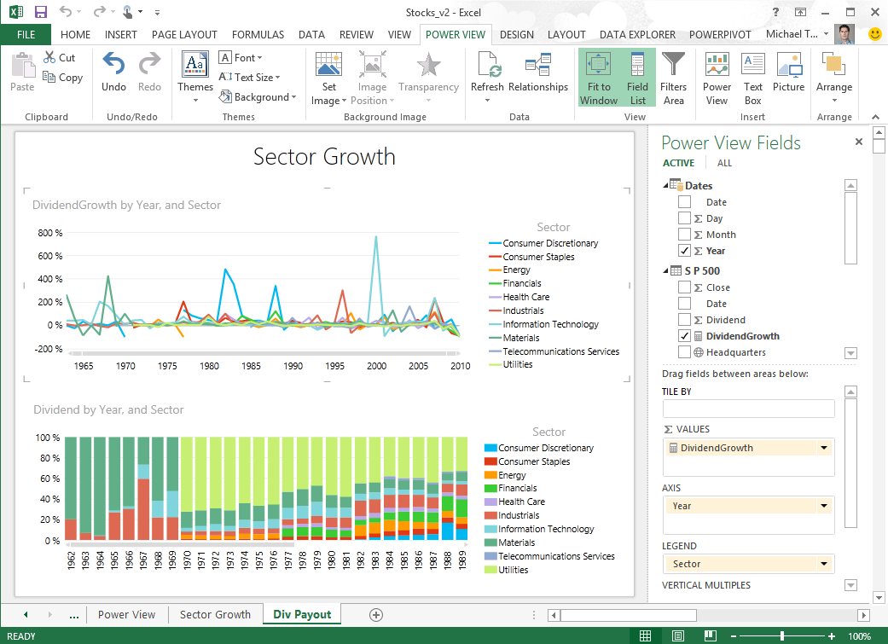
Powerful Self-Service BI with Excel 2013
Discover & Combine
Search and find internal & external data
Clean, transform, and shape data
Merge and combine data from multiple sources
Power View
Analyze & Model
Lightning fast analytics with xVelocity in-memory technology
Model relationships, custom measures, hierarchies, and KPI’s
Visualize & Explore
Bring your data to life with interactive visualization
Explore data in new ways to uncover hidden insights
Notes:
Power View: Discover and share new insights through interactive data exploration and visualization experiences with Power View in Excel. Power View lets you compile data, charts, and graphs into a single view to bring your data to life.

Slide 40

Power Query
Suited for self-service data that fits in Excel
Data driven shaping – design while you drive
Ideal for sampling data
Partition data in Hadoop/Hive based on user workloads
No governors to prevent users from pulling “too much data”
Does not read compressed or binary files (yet)
Search, Access & Shape
Simplify access to data in Hadoop
Easily preview, shape, & format your data
Combine with Unstructured
Combine and refine data across multiple sources
Gain insight across relational, unstructured, & semi-structured data

Slide 41
結論
盡可能地蒐集更多的資料，並從中找出新的商業價值
HDInsights on Azure 具有資源彈性及延展性可以用來處理大量的非結構化資料
Microsoft BI 與 Hadoop 整合以便從結構化或非結構化資料中取得商業洞察

Slide 42
Get Started
Read documentation
http://azure.microsoft.com/en-us/documentation/services/hdinsight/
Learning Map
http://azure.microsoft.com/en-us/documentation/articles/hdinsight-learn-map/
Microsoft Virtual Academy
http://www.microsoftvirtualacademy.com/training-courses/getting-started-with-microsoft-big-data
Channel 9 Data Exposed Show
http://channel9.msdn.com/Shows/Data-Exposed
Try 30 day trial
http://azure.microsoft.com/en-us/pricing/free-trial/

